Slide 1

WORKING WITH THE DEAF AND
HARD OF HEARING COMMUNITY
& VRI BEST PRACTICES
Victor Collazo
ASL Center Manager

Slide 2
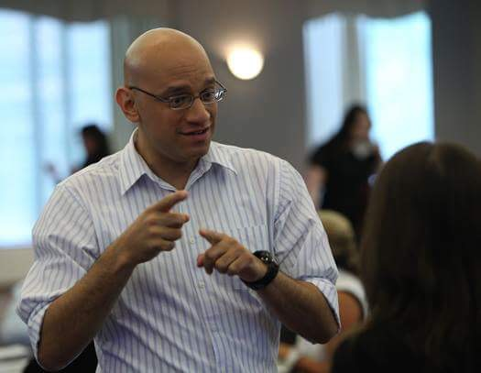

Victor Collazo
Victor Collazo is a nationally certified, professional American Sign Language (ASL) interpreter. He holds a Master-level National Interpreter Certification, and has more than ten years' experience interpreting for the Deaf and Hard of Hearing.
Victor has held the position of ASL Center Manager for CyraCom for the past three years. His primary responsibilities include overall management of ASL interpreters and overseeing CyraCom's ASL interpretation line of business. Victor holds a bachelor's degree from Rutgers University in Science, and earned a degree from Camden County College in ASL Interpretation. Victor hosts annual community forums for the Deaf and Hard of Hearing community, where he discusses relevant issues pertaining to video remote interpretation.
Introduction

Slide 3
Dispelling Misconceptions
Understanding ASL
ASL Interpreter Qualifications
What About VRI?
  Advantages
  Regulations
  Best Practices
Making that Human Connection
Agenda

Slide 4

Misconceptions - Can You Read My Lips?
Notes:
Andrew

Slide 5



Writing back and forth is a good way to communicate with EVERYONE who’s deaf.
Speaking slowly
will help.
Speaking in the third person is fine.
“Interpreter, please ask Mr. Smith why he is here.”
Family and friends are qualified to interpret.
Seen frequently. May lead to errors and liability.
Misconceptions - Myths
Notes:
Writing back and forth is usually ineffective: Syntax and Grammar of ASL and English are different
May cause misunderstanding on both parts (Deaf and Healthcare professional)
Speaking slowly should only be done if Deaf patient asks you to speak slowly
If Deaf patient doesn’t ask you to speak slowly but you ( Healthcare provider) do it anyway, could be looked at as if you are “talking down” to the Deaf patient. (Possibly offending Deaf patient)
Healthcare provider should always speak to Deaf patient in the “first person”. Example How are you Mrs. Smith?
Healthcare provider should also keep eye contact with Deaf patient not the interpreter.
Understand that there may be some “Lag time” interpreting between languages.
Family are friends are not qualified to interpret. Most do not have a solid grasp of ASL.
Emotionally engaged in Deaf patients life (conflict of interest)
Patient may want to use family member. Should be encouraged not to

Slide 6
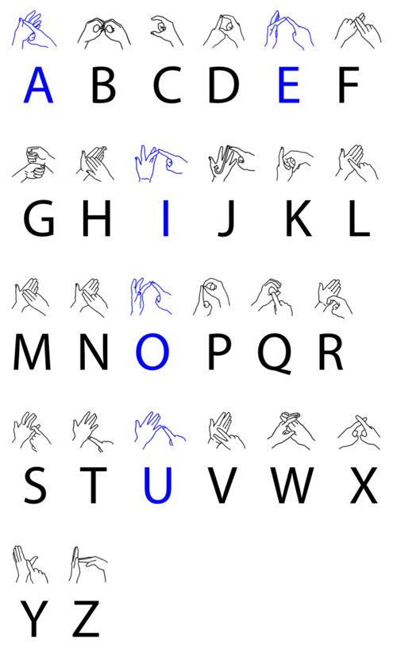
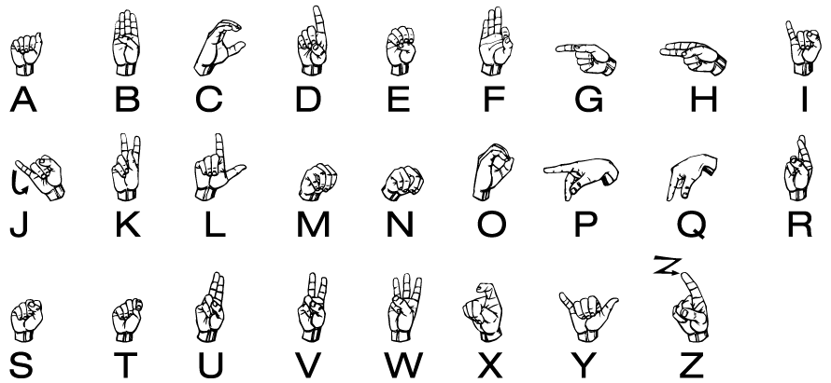
The biggest misconception:
“ASL is a universal language.”
Misconceptions
Notes:
ASL is not used in all countries (only in USA and most of Canada- ASL and LSQ)
Examples are the ASL alphabet and British Alphabet (two handed alphabet). (Same letters but different structure. )
Each country has its own form of sign language.

Slide 7
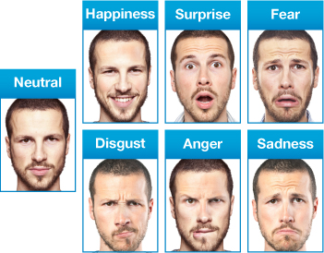



Understanding ASL
Notes:
ASL is not just a bunch of signs
ASL includes signs, FS (finger spelling), facial expression, body language, eye contact and mouthing
Hearing individuals should try and be more aware of their facial expressions and body language before communicating to a Deaf patient.
If you are having a bad day, I promise you that the Deaf patient will pick that up in your facial expression and body language.
Provide “universal signs of warmth” such as… SMILE, THUMBS UP, A-OK.. These go a long way in providing a positive patient interaction.

Slide 8
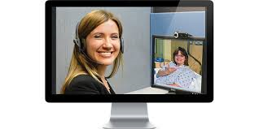
What are the qualifications for an ASL Interpreter?
  Most attend an ITP (Interpreter Training Program)- 4 Year Program
  Mentoring with certified ASL interpreters
  State Screenings
  National Test- RID
  CODA’s – Children of Deaf Adults
ASL Interpreter Qualifications
Notes:
What’s the difference between this and CDI?
CDI qualifications:
Native language user- ASL.
Mentoring with a trained/licensed CDI
Certification through RID
Interpreter Training Program- Option

Slide 9

Why VRI?
  Faster in certain situations (last-minute procedures)
  Frees up in-person interpreters to focus on most critical patient encounters
  Cost savings of avoiding minimum usage requirements
  Improved access to needed languages in rural areas
  Medical consideration: Anonymity
VRI - Advantages

Slide 10

What does the Department of Justice think of VRI?
    Entities can choose VRI or on-site
    VRI can be useful in rural areas where on-site
    interpreters may be difficult to obtain.
    May be cost effective
  However,
    “VRI will not be effective in all circumstances”
http://www.ada.gov/effective-comm.htm
VRI - Regulations
Notes:
“The new regulations give covered entities the choice of using VRI or on-site interpreters in situations where either would be effective. VRI can be especially useful in rural areas where on-site interpreters may be difficult to obtain. Additionally, there may be some cost advantages in using VRI in certain circumstances. However, VRI will not be effective in all circumstances. For example, it will not be effective if the person who needs the interpreter has difficulty seeing the screen (either because of vision loss or because he or she cannot be properly positioned to see the screen, because of an injury or other condition). In these circumstances, an on-site interpreter may be required.”

Slide 11




DOJ Standards for VRI:
HIGH-SPEED
CONNECTION
CLEAR
VIDEO
CLEAR
SOUND
STAFF
TRAINING
http://www.ada.gov/effective-comm.htm
VRI - Regulations
Notes:
If VRI is chosen, all of the following specific performance standards must be met:
real-time, full-motion video and audio over a dedicated high-speed, wide-bandwidth video connection or wireless connection that delivers high-quality video images that do not produce lags, choppy, blurry, or grainy images, or irregular pauses in communication;
a sharply delineated image that is large enough to display the interpreter’s face, arms, hands, and fingers, and the face, arms, hands, and fingers of the person using sign language, regardless of his or her body position;
a clear, audible transmission of voices; and
adequate staff training to ensure quick set-up and proper operation.

Slide 12

Selecting VRI Equipment
    Screen Size (Key consideration)
    Integrated Webcam + Speakers
    Portability
    Security
    Charging
    VRI App
Allocating VRI Equipment
    Place one unit in ED
    Additional units in high-usage areas
    Nurse Manager in charge of VRI unit
    Check back in for charging
VRI – Best Practices

Slide 13
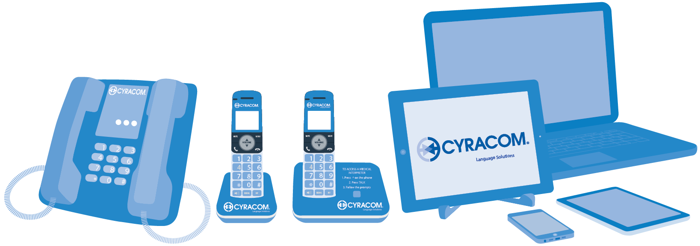
Introducing VRI
    Provide training to all staff
    Set expectations for when to use:
      Employee interpreters
      Agency
      Phone (not for Deaf and Hard of Hearing patients)
      Video
VRI – Best Practices

Slide 14
Positioning VRI
    Position unit in front of the patient so they see screen
    Nurse/Doctor stands behind or right next to screen
    Maximize window
Increasing Patient Comfort with VRI
    Leave VRI cart in room with patient
    Explain that VRI is there for them 24/7
    Show them how it works
VRI – Best Practices
Notes:
Positioning of VRI unit is very important
ASL is a visual language so screen size is very important as is “maximizing” the ASL interpreters picture for patient.
Healthcare provider should sit or stand next two VRI computer so that the Deaf patient can focus on the ASL interpreter and Healthcare.
Keeping eye contact with patient not ASL interpreter is key for Healthcare staff.
Because VRI is 2-D, before interpretation begins Healthcare provider should explain to the interpreter who is participating in the room.
Healthacre provider should be aware of her/his body language and facial expressions when communication with the Deaf patient.

Slide 15
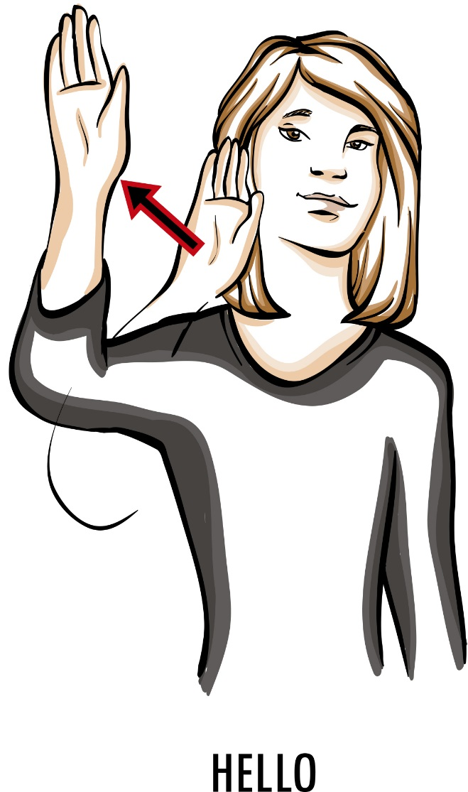
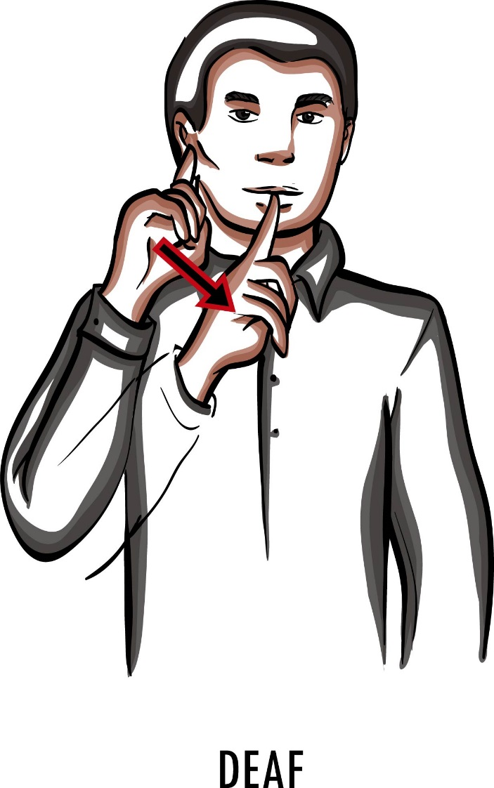

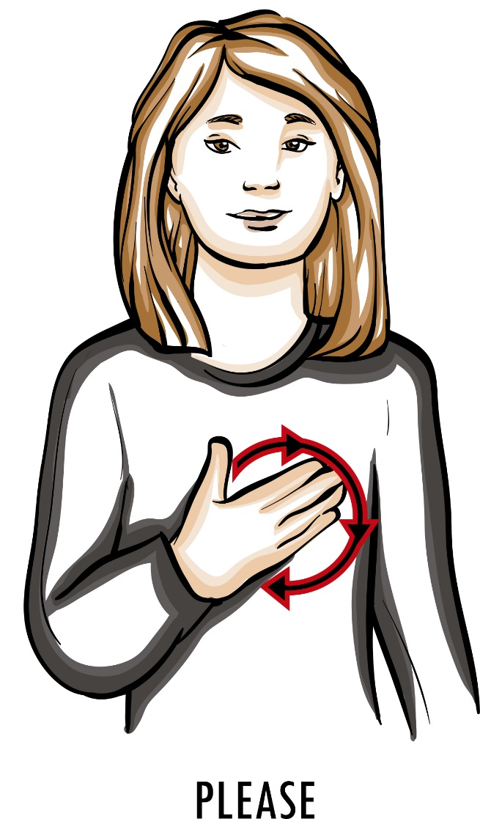
Making that Human Connection
Notes:
Creating that human connection with any patient is key!
How we do this with a Deaf patient is by learning a single sign. Showing a simple gesture “ Thumbs up”

Slide 16
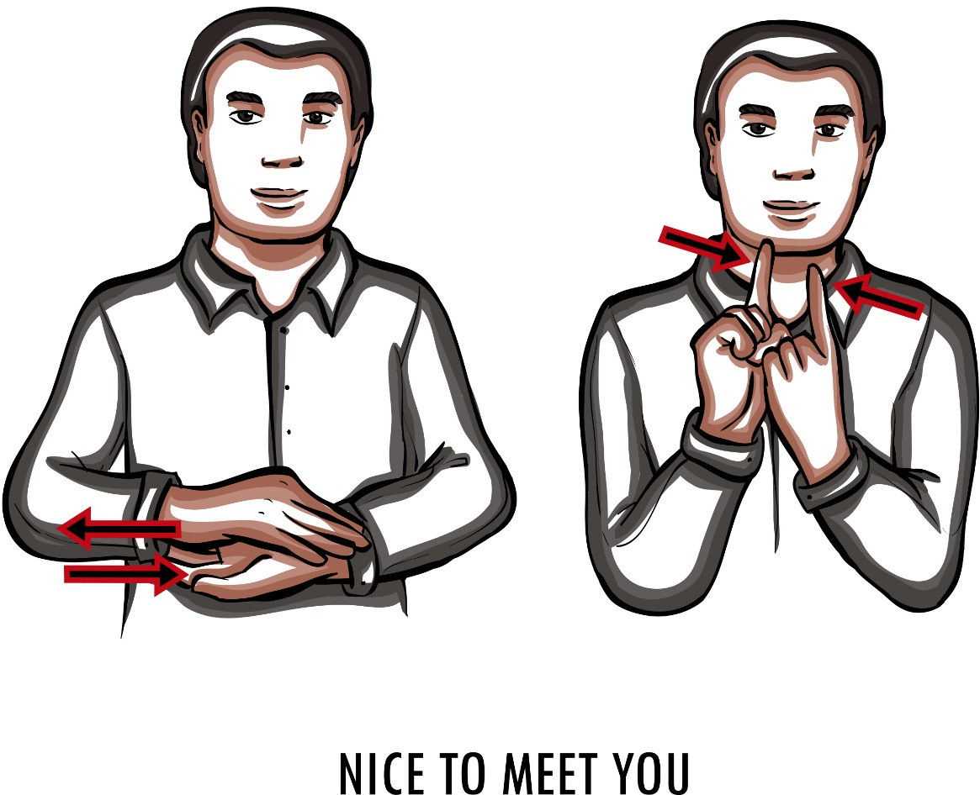
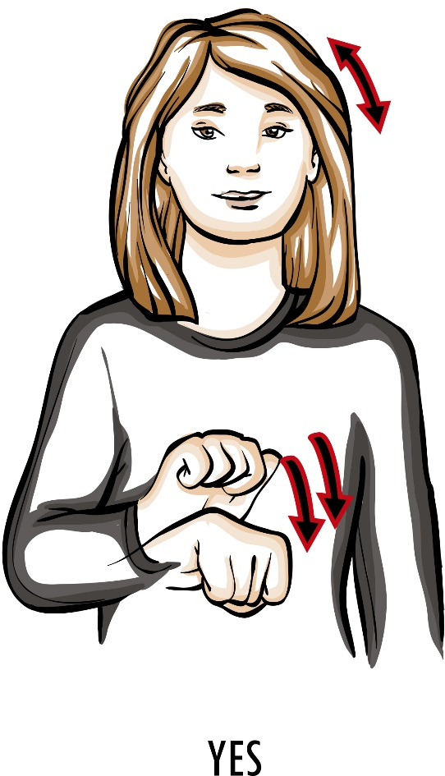
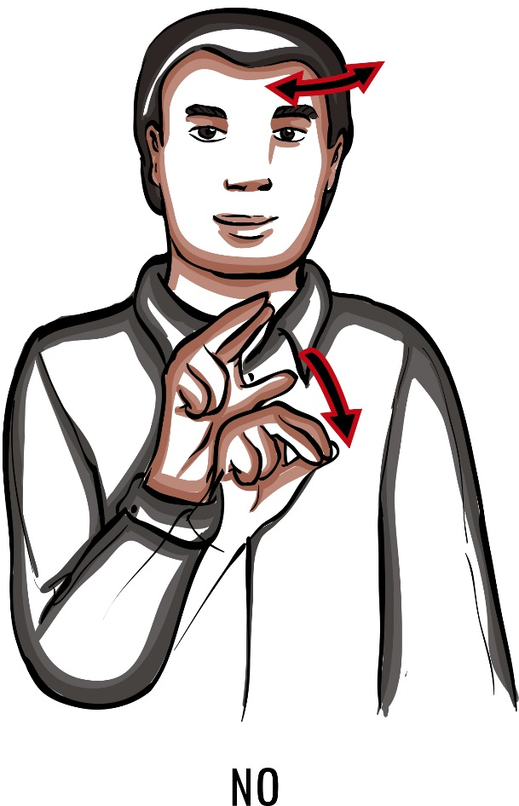
Making that Human Connection

Slide 17

Making that Human Connection

